Slide 1
INDIA’S AGGRICULRAL CROP PRODUCTION
USING TABLEAU FOR NAAN MUDHALVAN

Slide 2
1. INTRODUCTION
Agriculture Crop production is the process of growing crops for domestic and commercial purposes. Some of the crops produced on a large scale include rice, whear, maize, jute, etc...
2.CONTENT
Content analysis involves systematic study of messages conveyed in natural language text. In political research for Agriculture Crop Production

Slide 3
2.PURPOSE
Crop production is one of the fundamental branches of agriculture. Crop production is the basis for providing the livestock industry with feed, and the population with food.
ADVANTAGE&DISADVANTAGE
Crop products are used in many industries as raw materials of plant origin, such as food, textile, pharmaceutical, fuel and others.
Water Pollution. Heavy chemical runoffs from fields due to industrial agriculture penetrate water bodeies, poisoning aquatic populations. Deforestation and cuts of buffer strips for riverbank fortifications cause floods and sendimentation.

Slide 4
3.NEED For AGRICULTURE
Agriculture encompassees crop and livestock production, aquaculture, fisheries and forestry for food and non-food products. Agriculture was the key developement in the rise of sedentary human civilization, whereby farming of domesticated species created food surpluses that enabled people to live in cities.

Slide 5
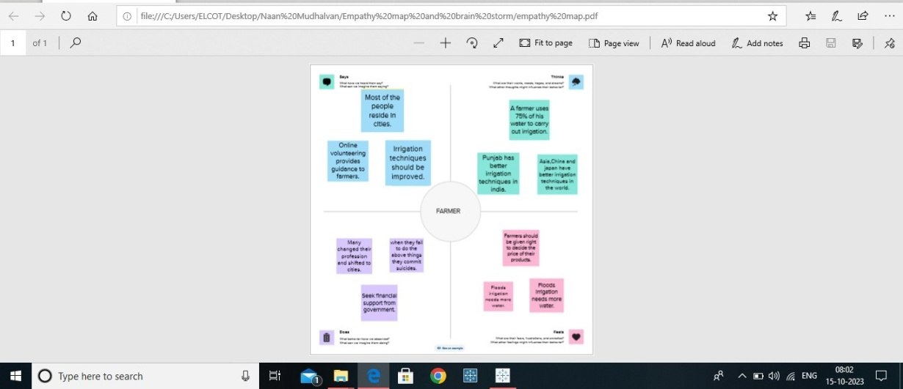
4.Empathy Map
Step 1- download the MURAL app sign in
Group Title- India’s Agricultural Crop Production created the project with teamwork.
Created the empathy map used to MURAL app

Slide 6
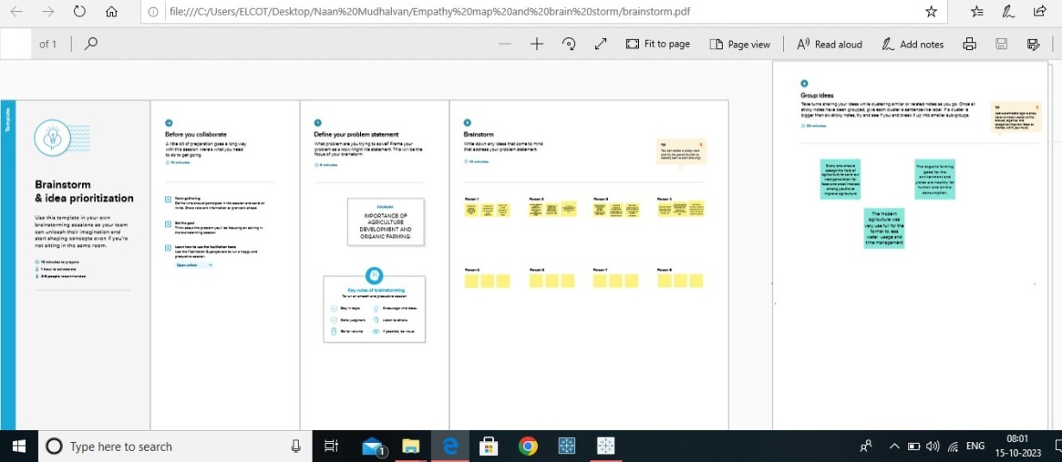
5.Brainstorming Map
Created to the Brainstorming Map
Used by MURAL app with team work

Slide 7
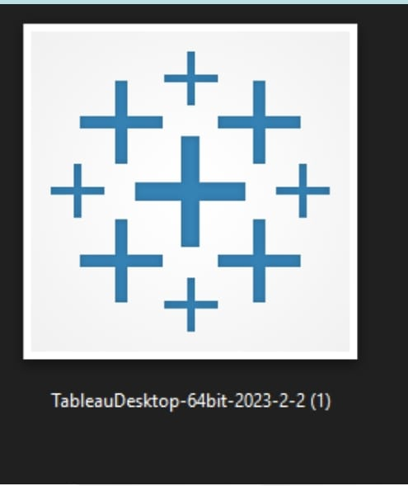
6.Tableau Desktop
Download the Tableau Desktop app (only 14 days)
Then, the group title is India’s Agriculture Crop Production
Created the project with team

Slide 8
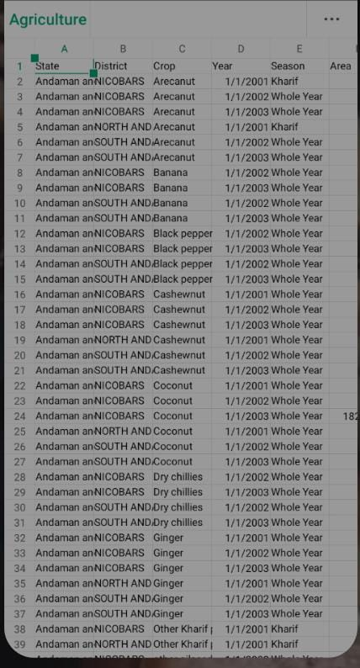
7.DATASET
Collected the DATASET
Edited the DATASET
It is used for project creating

Slide 9
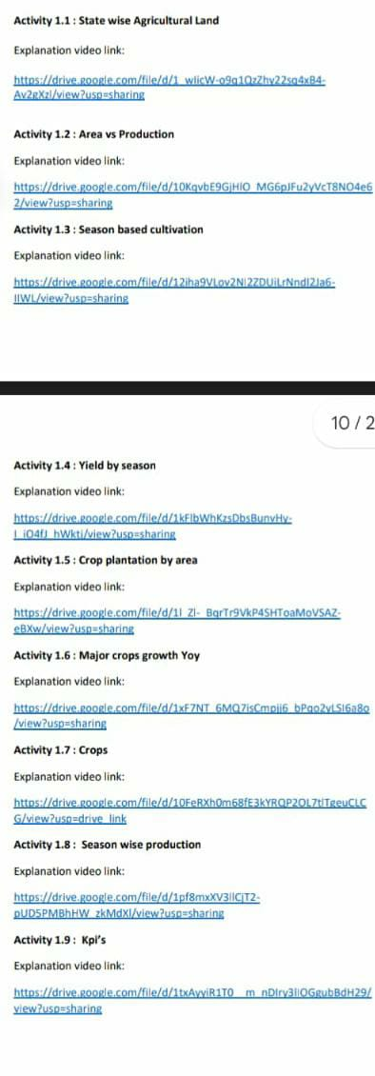
8.PROJECTS
USED TO THE LINKS TO HOW TO CREATED THE PROJECTS
IT IS DATA VISUALIZATION PROJECTS

Slide 10
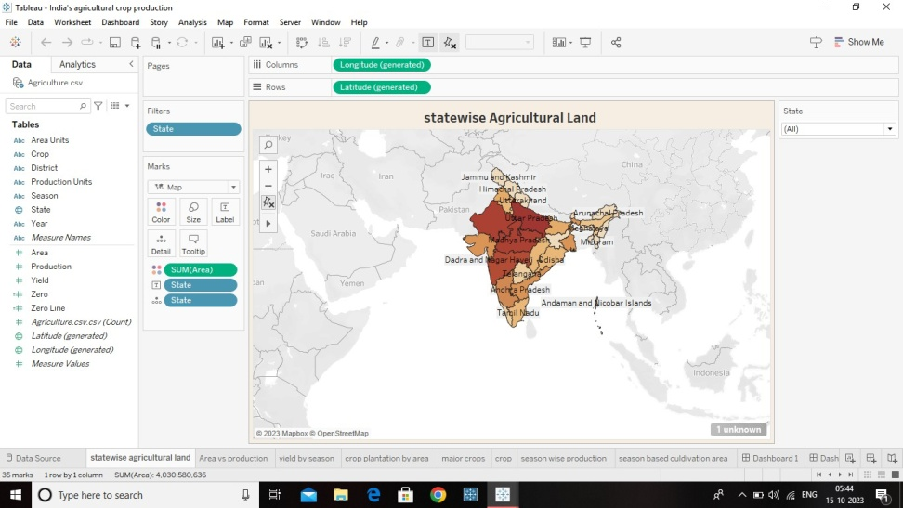
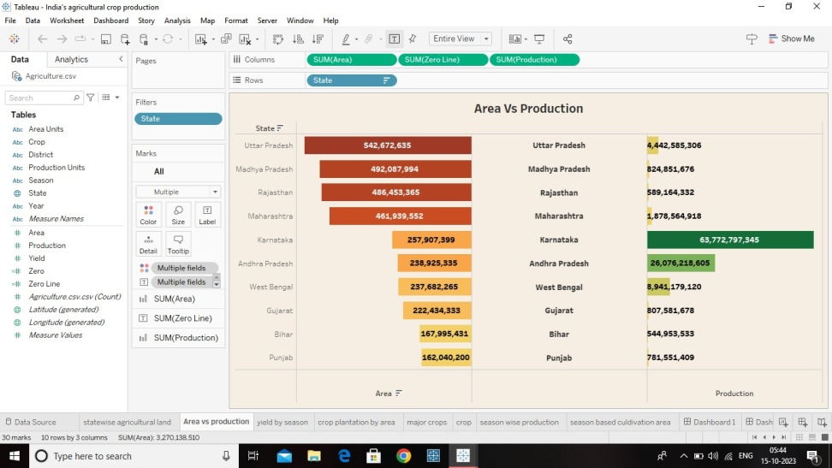
VISUALIZATION’S
Activity 1.1
Activity1.2

Slide 11
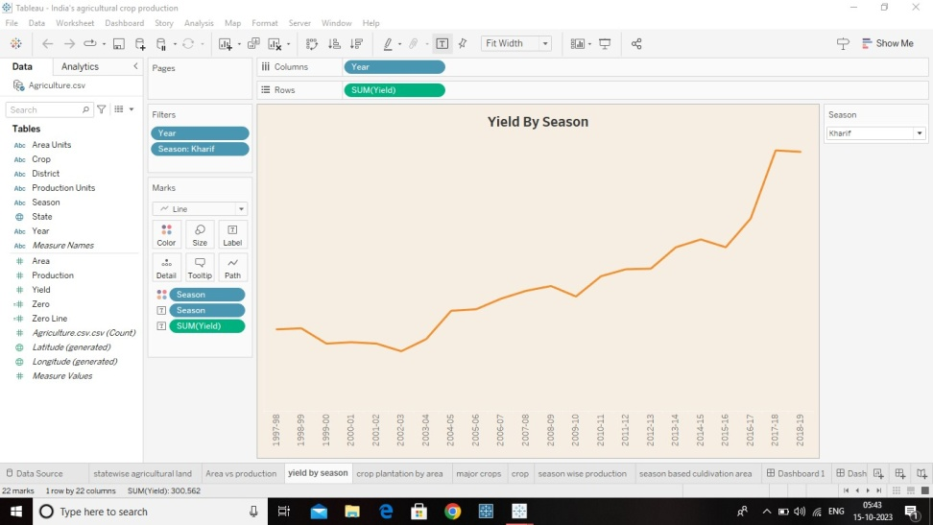
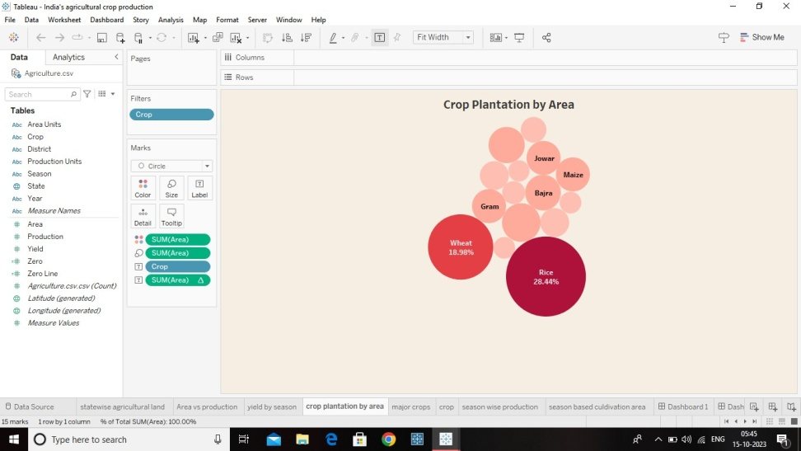
VISUALIZATION
Activity 1.3
Activity 1.4

Slide 12
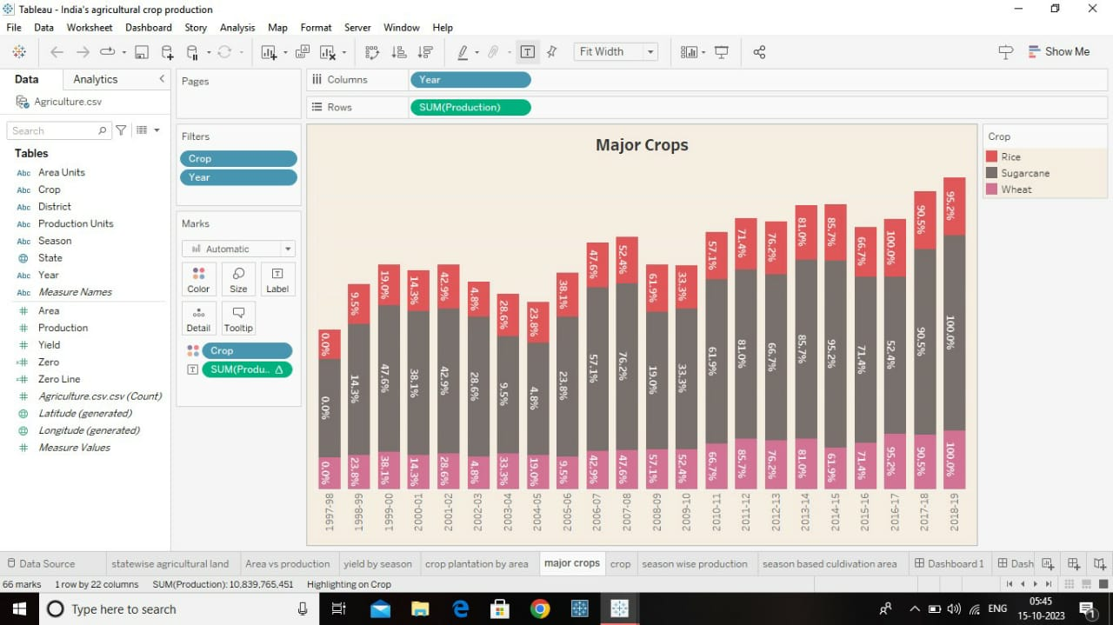
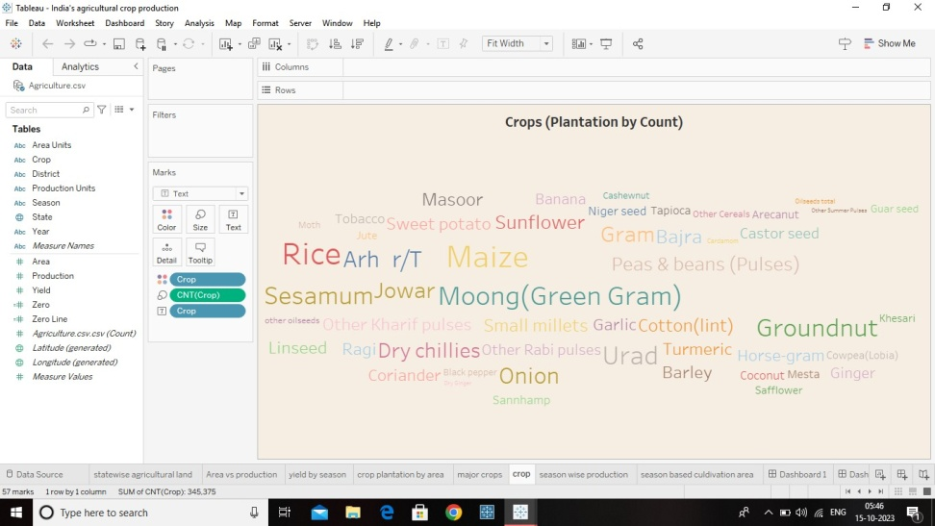
VISUALIZATION
Activity 1.5
Activity 1.6

Slide 13
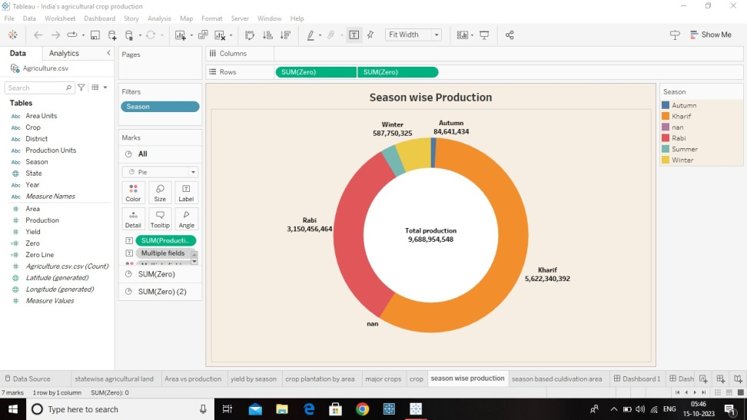
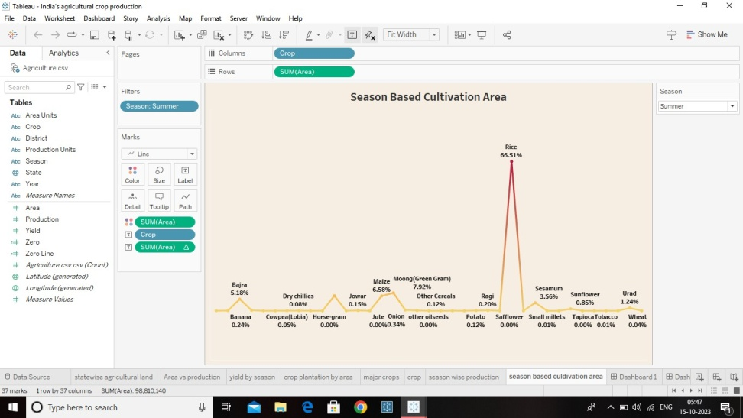
VISUALIZATION
Activity 1.7
Activity 1.8

Slide 14
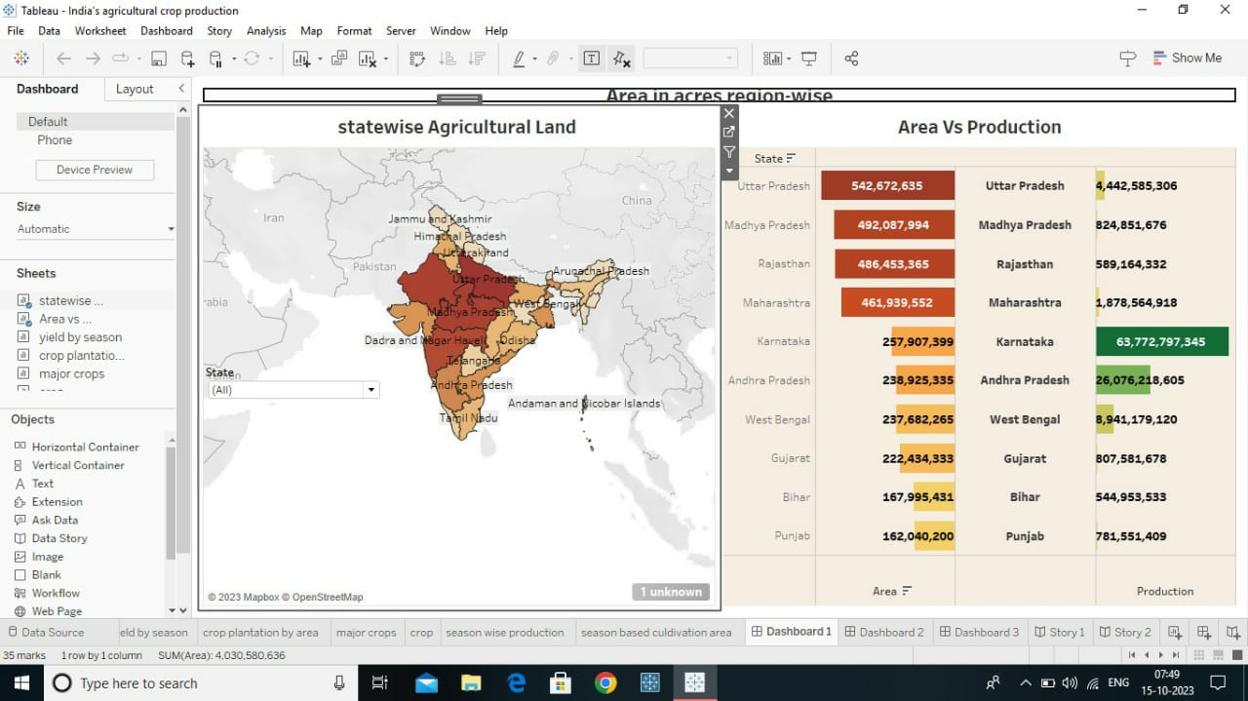
DASHBOARD 1
Add the work sheet
The dashboard was created

Slide 15
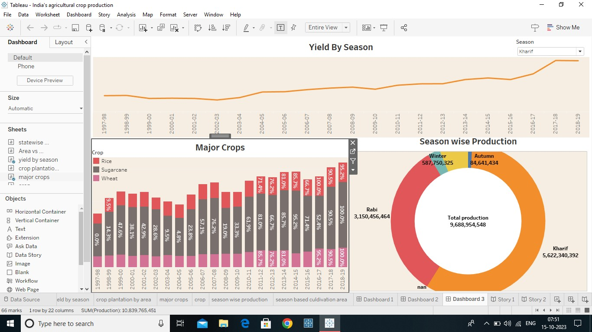
DASHBOARD 2
Add the work sheet
The dashboard was created

Slide 16
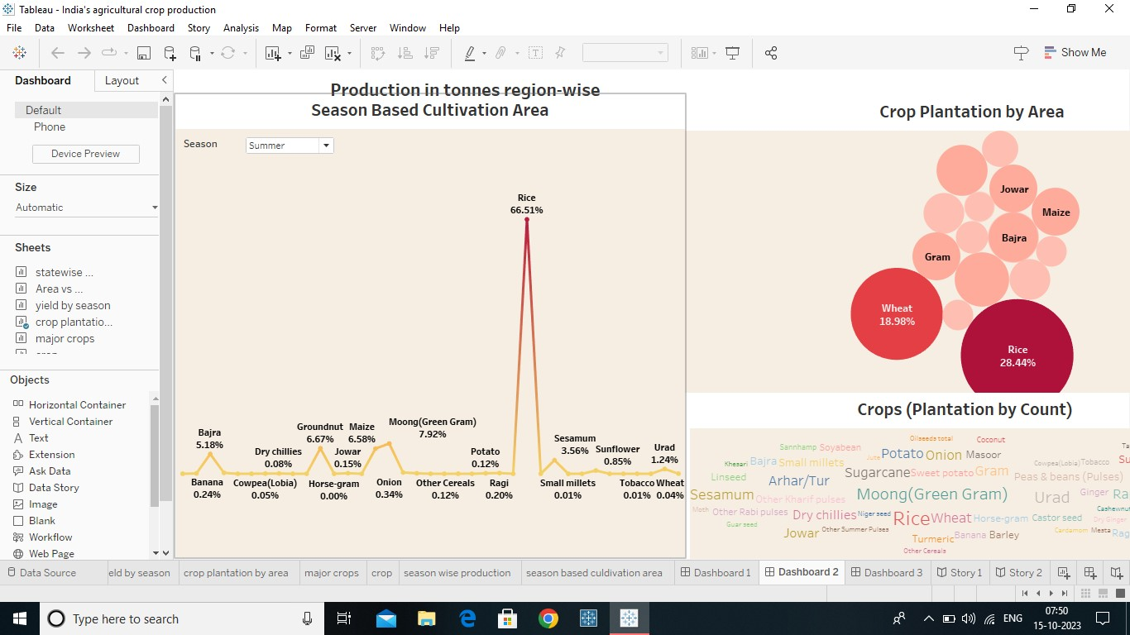
DASHBOARD

Slide 17
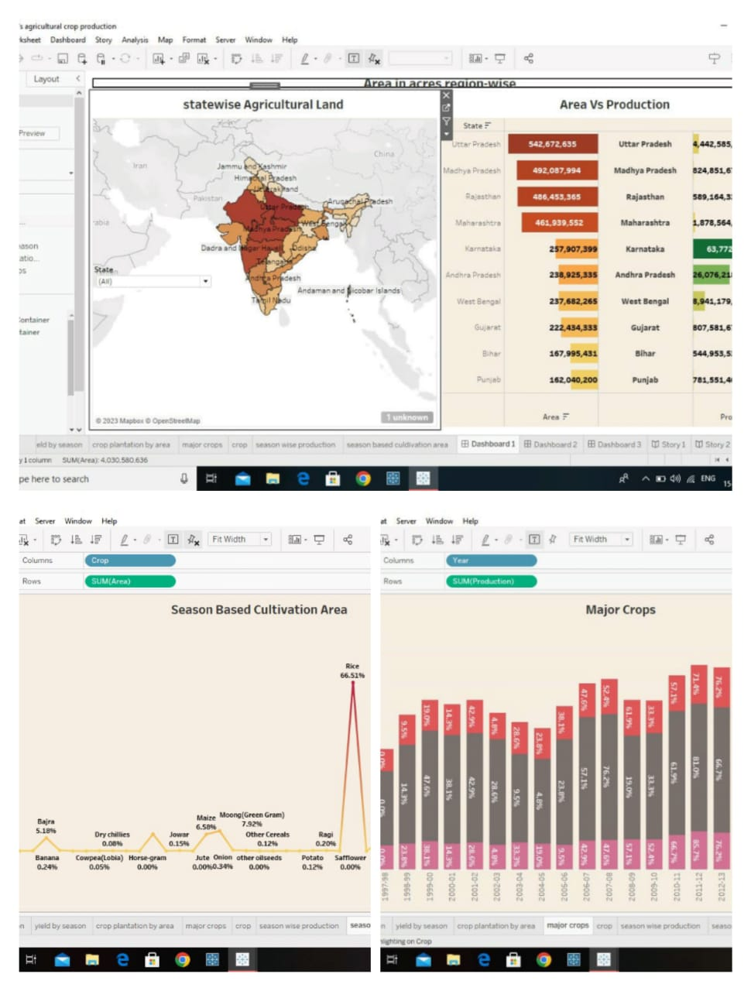
STORY CREATED 1
Story created same procedure of dashboard created
Example Activity 1 to 4 and added the Dashboard’s
Created the story one by one sheets with captain and added to Dashboard 1, 2, 3 and 4
Story was Created.

Slide 18
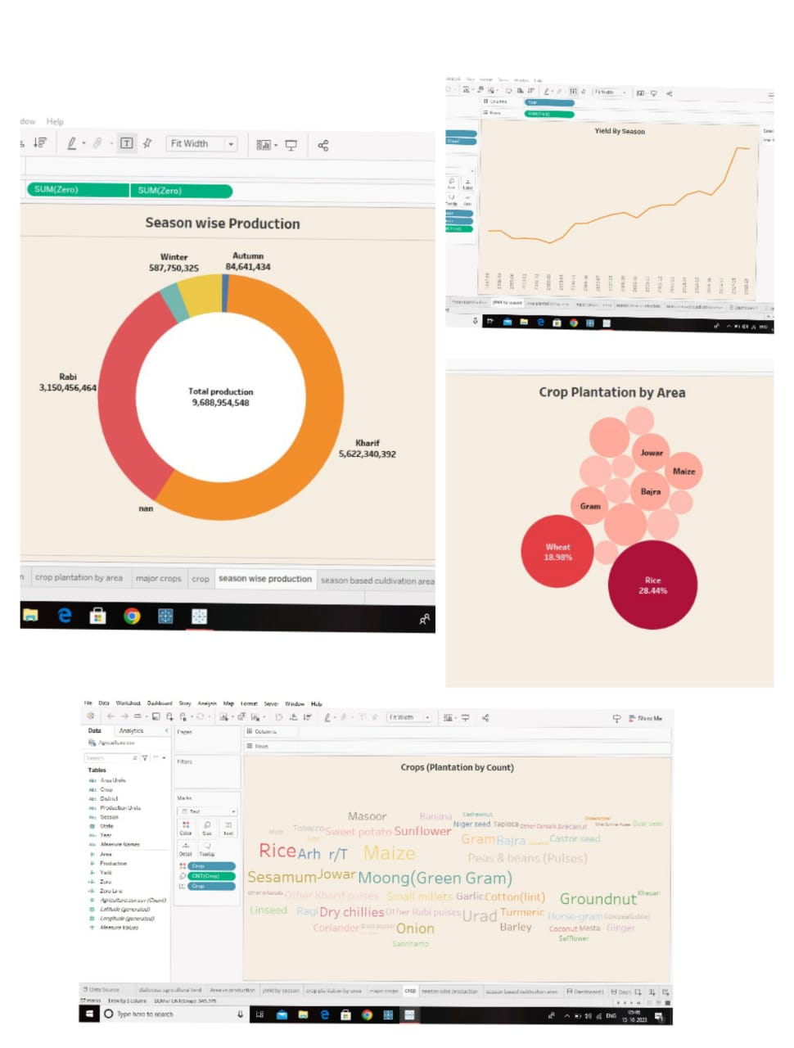
STORY CREATED
Story created same procedure of dashboard created
Example Activity 1 to 4 and added the Dashboard’s
Created the story one by
one sheets with captain and added to Dashboard 1, 2, 3 and 4
Story was Created.

Slide 19
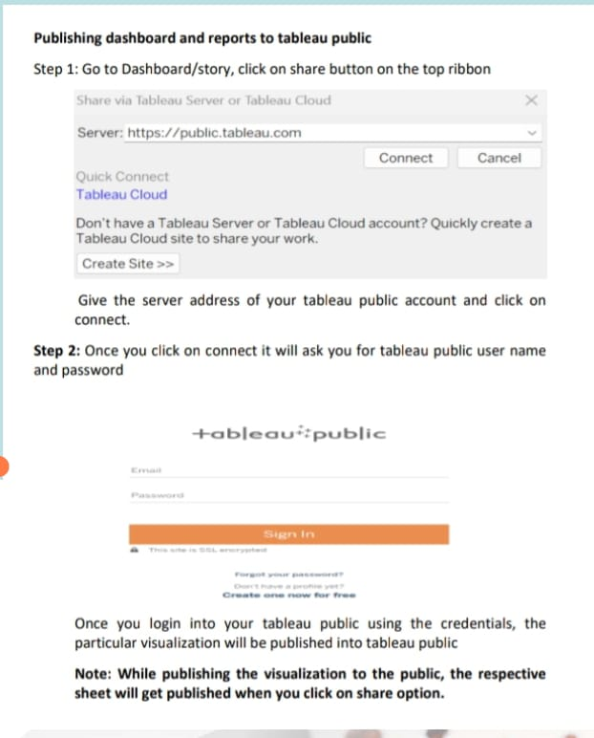
Tableau public created
Open in server and used to the link of
https://public.tableau.com and connected
Created the user Name and Password.
Created the account for tableau public.
Then share to the Dashboard 1,2 and 3,and story info the tableau publishing server
Upload the public
Then copy to the final link, and check to the profile

Slide 20
Application and Conclusion
fiber-rich crops like bamboo can be turned into a pulp, which can then be used to make paper. Oil crops are grown either for primary (human consumption) or secondary (industrial) uses. Edible oil crops include corn, sunflower, and olives. Soybeans are the world's most popular oil crop.

